Slide 1

EXPLORING WORLD’S TOP YOUTUBE CHANNELS

Slide 2
INTRODUCTION
OVERVIEW:
T-series: Known for music videos and Bollywood content.
SET India: Features Indian television shows and drama.
Like Nastya: A children’s content channel with diverse videos.

Slide 3
PURPOSES:
There are many popular channels across various niches, from gaming and teach to lifestyle and entertainment. If you have a specific category or channel in mind, feel free to ask, and I can provide more information are recommendations.

Slide 4
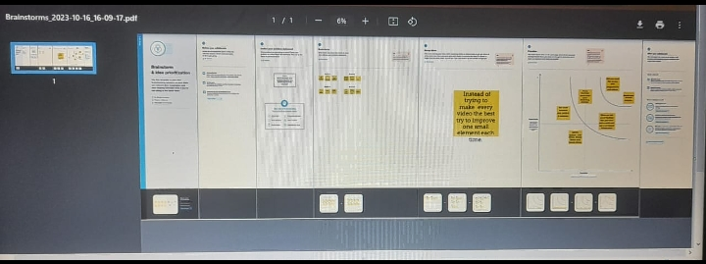
BRAINSTROMING

Slide 5
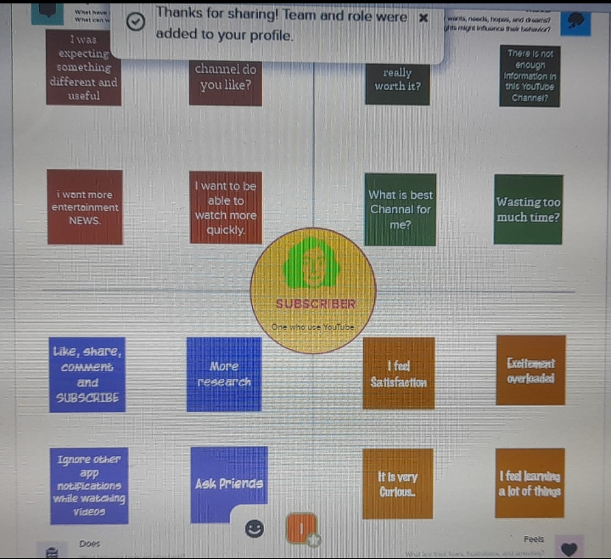
EMPATHY MAP

Slide 6
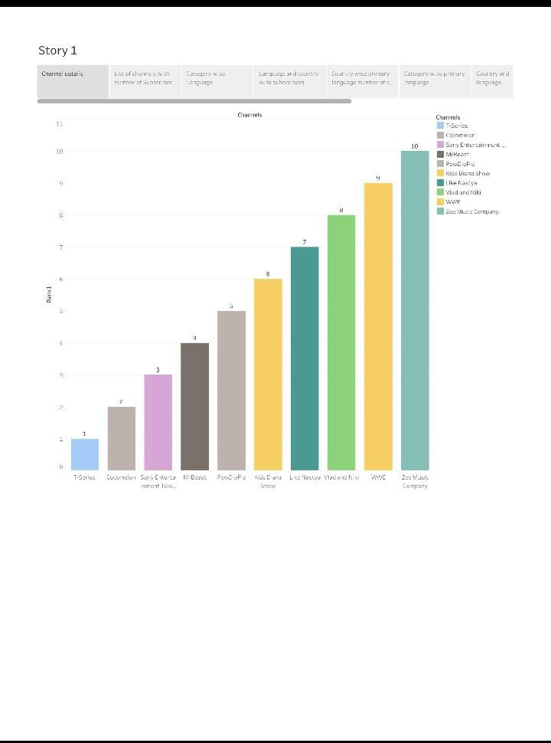
STORY 1

Slide 7
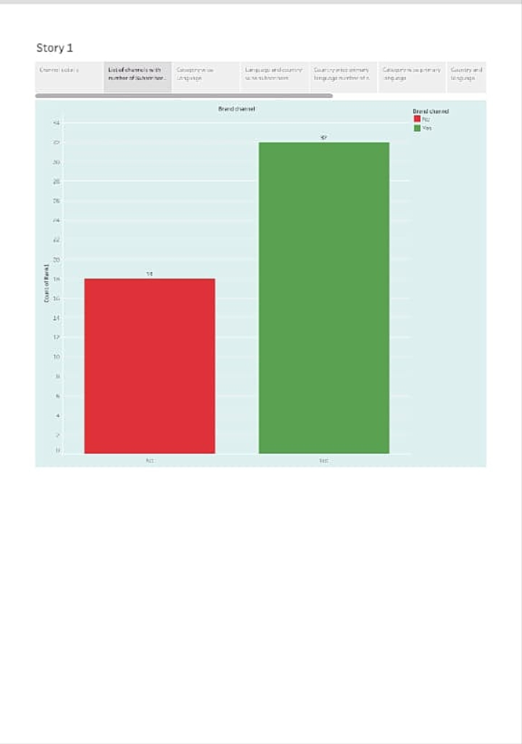
STORY 2

Slide 8
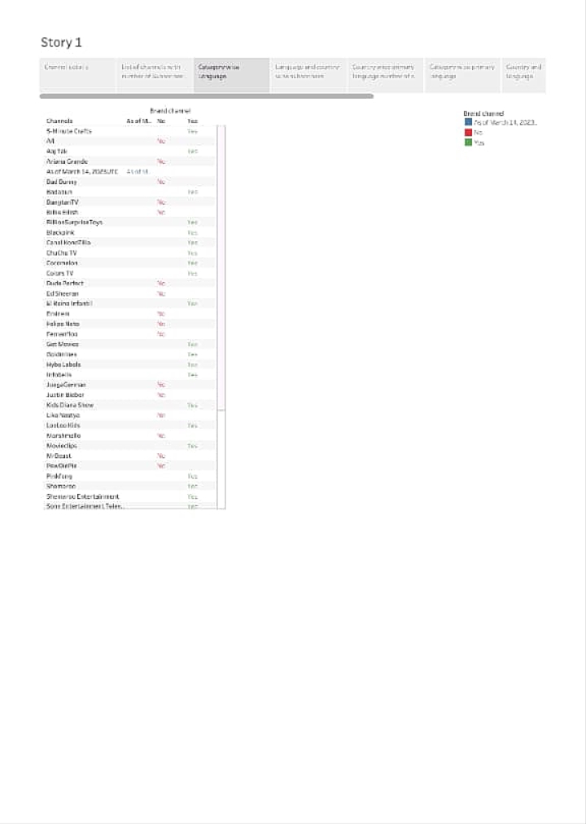
STORY 3

Slide 9
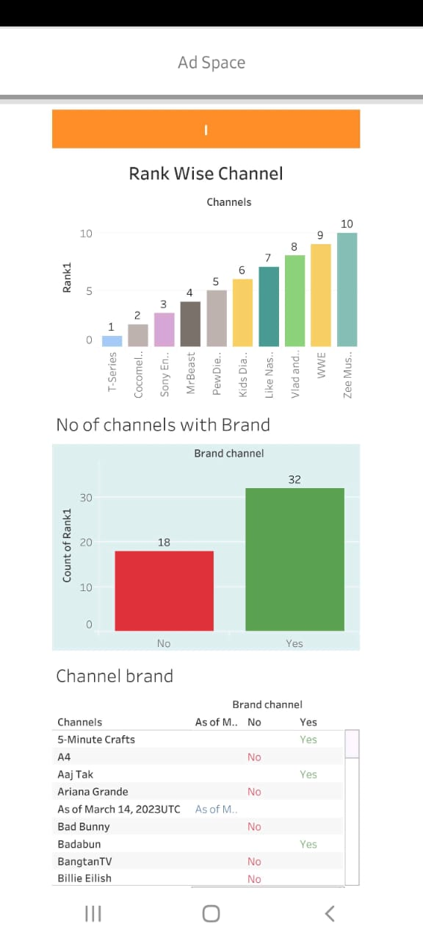
DASHBOARD 1

Slide 10
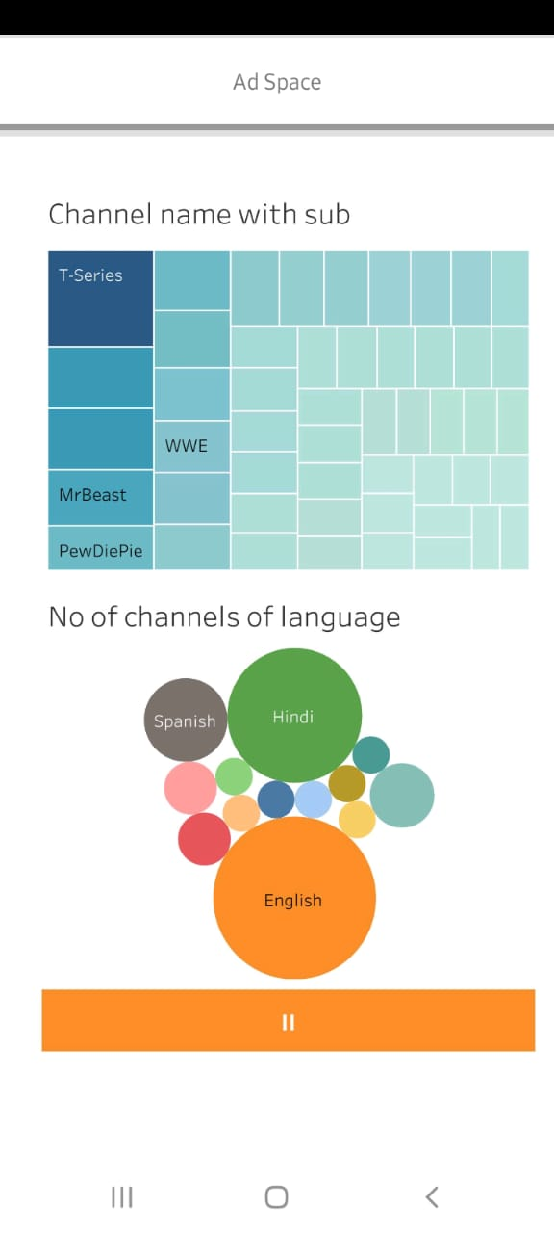
DASHBOARD 2

Slide 11
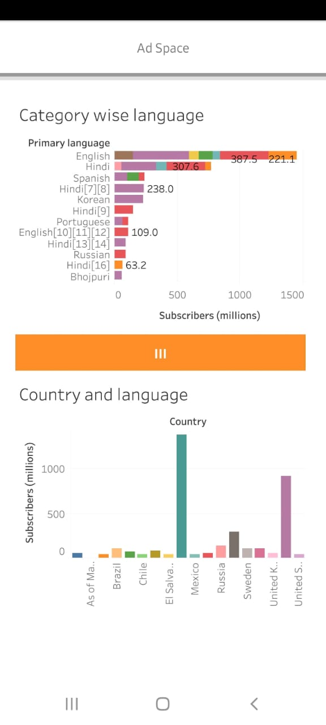
DASHBOARD 3

Slide 12
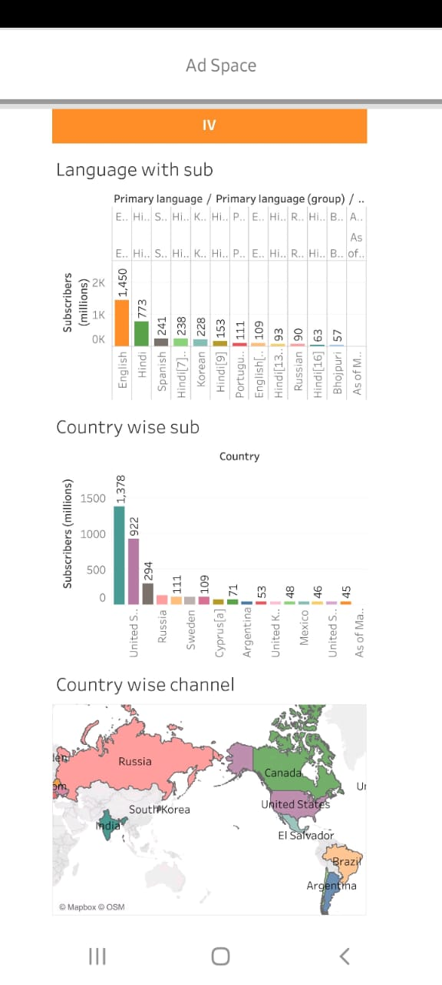
DASHBOARD 4

Slide 13
ADVANTAGES
Creators can earn revenue through ads, sponsorships, merchandise, and more , making it a potentially lucrative career.
Youtuber have the freedom to create a content on topics they are passionate about, without the constraints of traditional media.
They can build a loyal fan base, engage with their audience through comments and social media, and foster a sense of community.

Slide 14
DISADVANTAGES
Success on Youtube often relies on the platforms algorithms, making it challenging for some creators to gain visibility.
Income can be inconsistent, especially for smaller channels. Creators may face uncertainty in their earnings.
Creators must be cautions about copyright violations when using third-party content in their videos.

Slide 15
APPLICATION
You can use the Youtube app or website to browse and discover popular channels in various categories such as gaming, entertainment, education, and more. If you have specific questions or need recommendations, feel free to ask.

Slide 16
CONCLUSION
T-series- Know for music videos.
Cocomelon- Specializes in childrens nursery rhymes and animations.
SET India- Offers a variety of Hindi TV shows and entertainment content.
PewDiePie- Famous for gaming and vlogs.

Slide 17
FUTURE SCOPE
Channels offering a diverse range of content, including vlogs, educational videos, entertainment, and more, will likely gain more subscribers as viewers tastes diversify.
Live content and interactive streams are becoming increasingly popular, and channels that engage with their audience in real-time may see growth.
As youtube continuous to grow, channels focused on specific niches like space exploration, sustainability, AI, and virtual reality could gain substantial followings.

